Slide 1
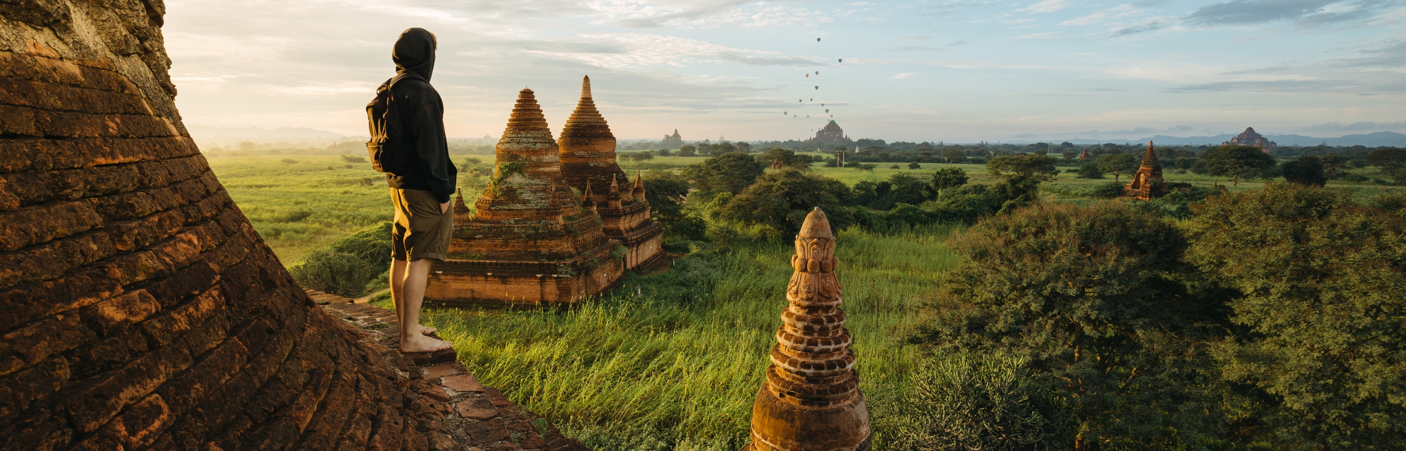
TRAVEL,TOURISM & HOSPITALITY

Slide 2
TEAM MEMBERS:
NAME: | ID NUMBER:
K.MANIKANTA REDDY(TEAM LEAD) | 2100032258
D.BHAGATH KRISHNA VAMSI | 2100032262
V.LAKSHMI SHANTHAN | 2100032365

Slide 3

TRAVEL:
Travel refers to the activity of travelers. A traveler is someone who. moves between different geographic locations, for any purpose. and any duration.
TOURISM:
Tourism is a social, cultural and economic phenomenon which entails the movement of people to countries or places outside their usual environment for personal or business/professional purposes.
HOSPITALITY:
Hospitality is the relationship between a guest and a host, wherein the host receives the guest with some amount of goodwill, including the reception and entertainment of guests, visitors, or strangers.

Slide 4
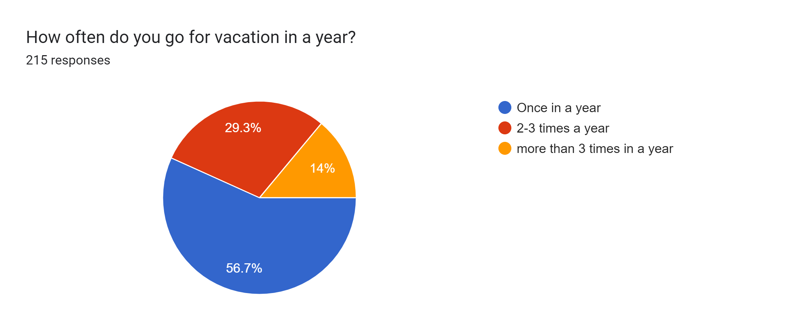
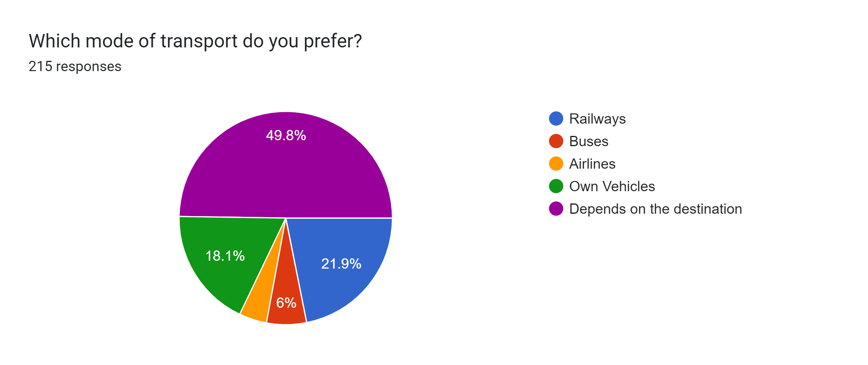
Results on online survey which we conducted:

Slide 5
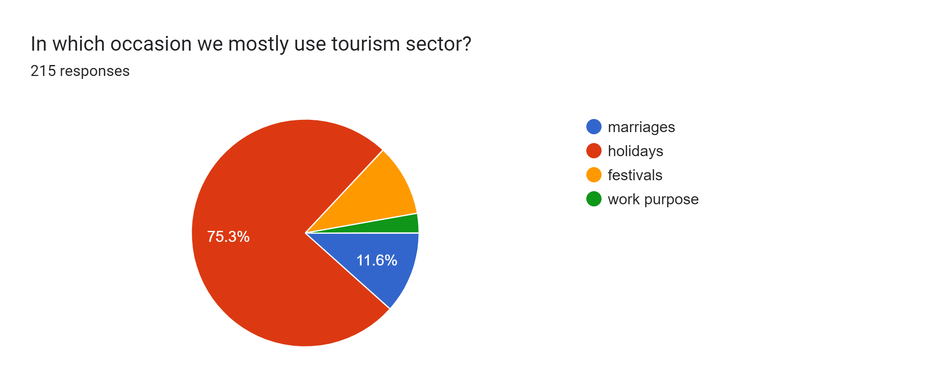
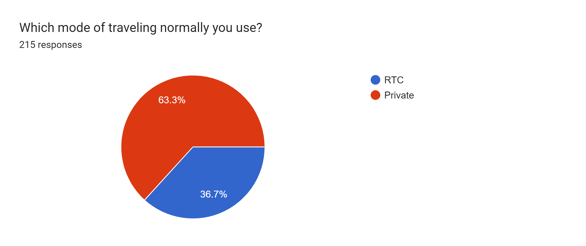

Slide 6
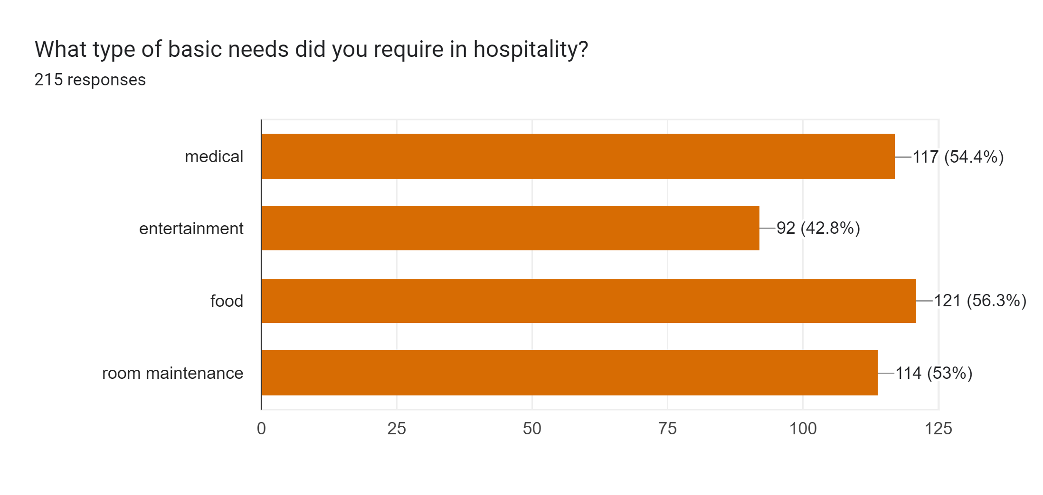

Slide 7
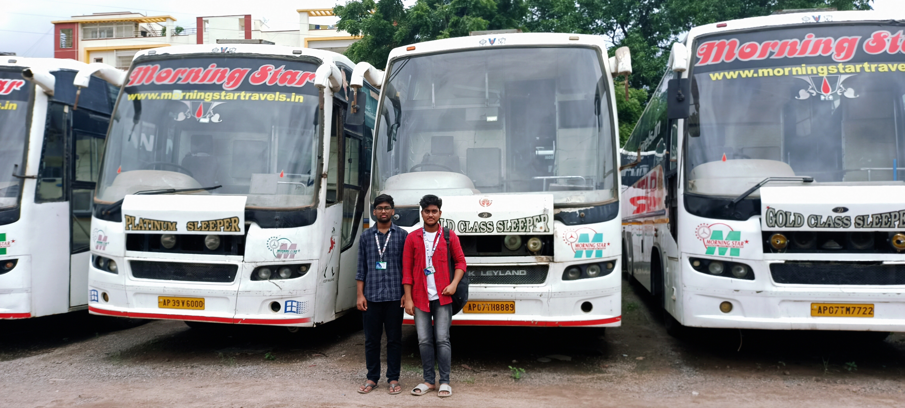
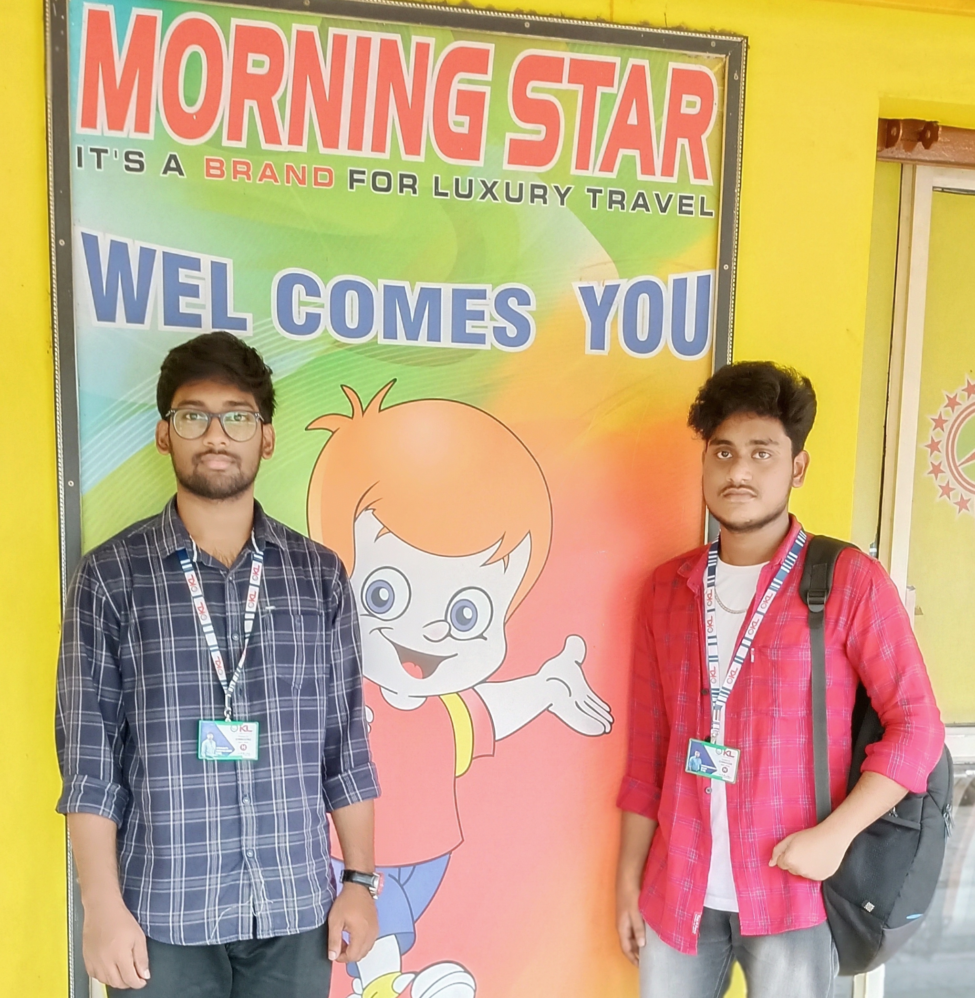
Photos taken during interaction and conducted surveys:
We conducted a survey in the Morning Star Travels, which is a private travel agency. They said they don't have any major problems, but they want it to be more user-friendly.
Travelers expect buses to be clean and comfortable, so we checked the condition of the buses and discovered what problems travelers are experiencing while traveling.

Slide 8
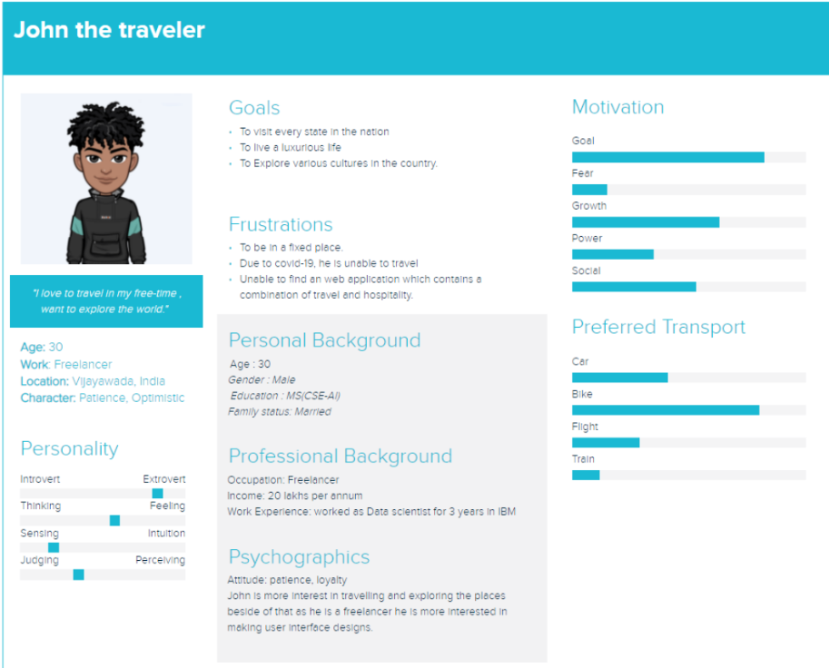
User Persona for the Business System

Slide 9

User Stories:
As a User, I want a user friendly website where I can book the tickets easily
As a User, I expecting the travel website to send softcopy of ticket through mail, What's app
As a User, I should be able to cancel my ticket whenever I want.
As a User, I should be notified whenever there are discounts.

Slide 10
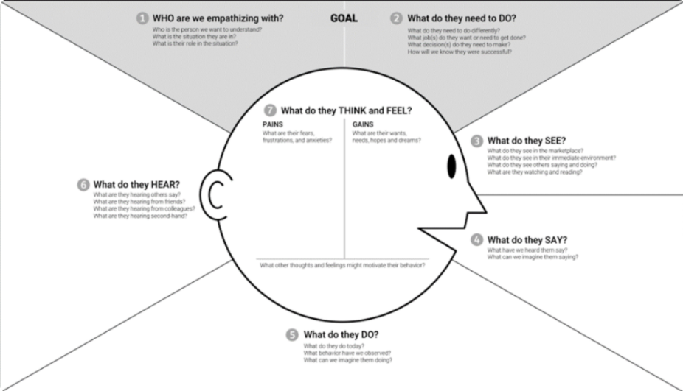
Empathy map:

Slide 11

By this survey we introducing an website
called:
hodophile
On this website we are coming to design a travel and hospitality based website. We are providing a multi-tourist place which is very famous in India. Also, we are providing the best information so that people can know how to reach their destination . And when it comes to hospitality, we are giving information for people who want to travel to their dream places. and providing a service for them by booking hotel tickets through our website. and also providing food while they travel, either from railways, buses, etc, through the help of this website . So this is the basic model we are coming up with for this website.

Slide 12
Modules we are including in this
website.

Slide 13

Online research websites:
https://www.ixigo.com/
https://www.redbus.in/
https://www.makemytrip.com/
Conducted survey link:
https://docs.google.com/forms/d/1usT3UBZmbSR5dRbSEzMlj74uPhWBGw5Br9xh6ORwnZc/edit

Slide 14
CONCLUSION:
Through this project we have learned how to create the user friendly website on the given business system. We have designed the website according to the user's need and requirements. We have learned many things about travel tourism and hospitality

Slide 15


HODOPHILE

